Slide 1
Auto-Plot
A web-app that automates plots
Sai Ram. K
20181CSE0621
7 – CSE -10

Slide 2
Introduction
In today’s world there has been a tremendous amount of data that has been generated constantly. Organizations and companies are heavily relying on the data generated in order to get valuable insights in order to derive hidden facts.
This gave rise to the domain of data visualization that helps the users understand the distribution and orientation of the numerical data in pictorial forms for feasible visuals.
The project also aims to integrate automation along with data visualization in order to achieve easy plotting.

Slide 3
Aim of the Project
This project aims to perform the different type of visuals by using various tools and packages in Python keeping the interactivity of the user to be the priority.
The implementation would help individuals with non-tech background to easily navigate and generate visuals as they please in order to gain insights and also facilitate an entire report that can be saved locally for further analysis.

Slide 4




Use of Modules
The following modules have primarily been used in the project:
Streamlit
Pandas
Pandas Profiling
Seaborn & Matplotlib

Slide 5
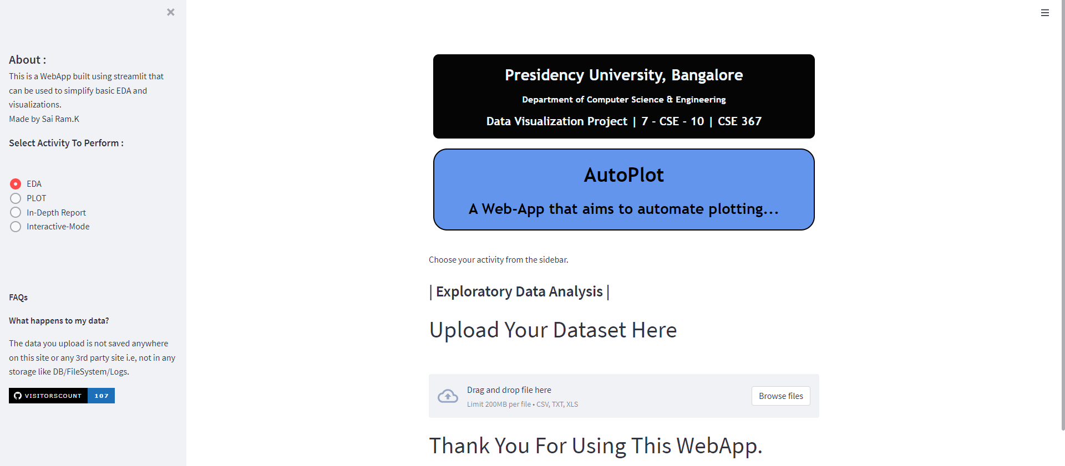
Web-App Structure

Slide 6
Components of the Web-App
In order to understand the working of the web- app, we understand the working and functioning of the components. The components are as follows:
File Uploader
Side Bar :
EDA
Plots
In-Depth Report
Interactive Mode

Slide 7
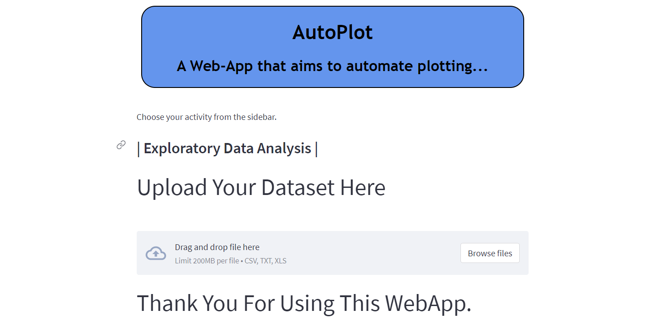
File Uploader
The section of the web-app that provides the user to upload the dataset in CSV format for further analysis.

Slide 8
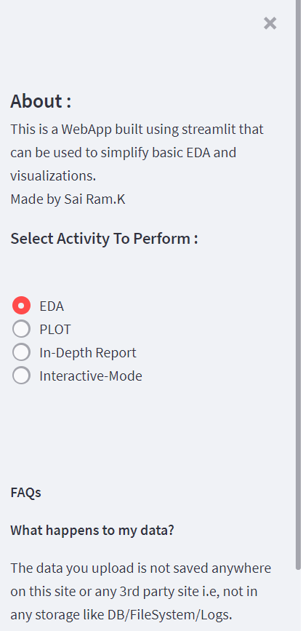
Sidebar
The sidebar component which allows the user to control the mode of plots that are to be generated and also answer certain frequently asked questions

Slide 9
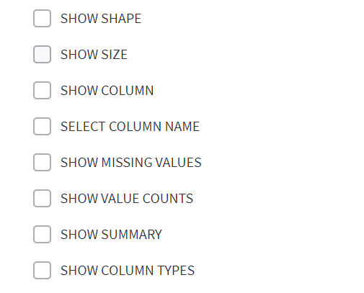
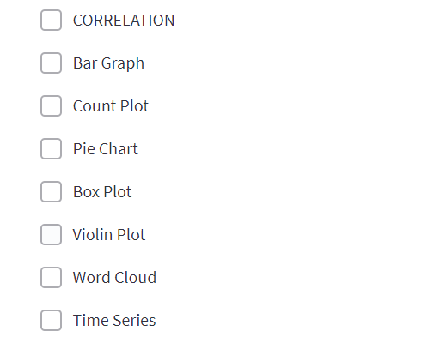
EDA and Plots
EDA Mode
Plots Mode

Slide 10
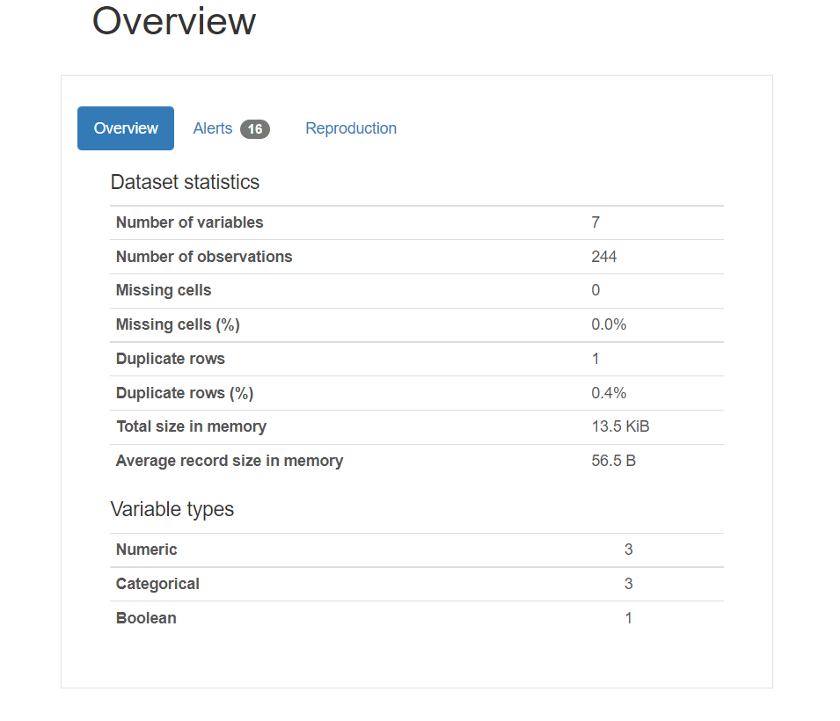
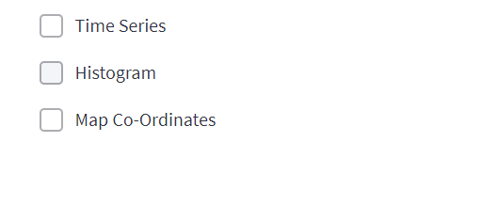
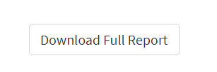
Interactive Mode and In-Depth Report
In – Depth Report
Interactive Mode

Slide 11
Code Snippets
In order to build the web-app, we split it into various components each of which add a unique functionality.
The snippets for the Plots can be seen in the upcoming slides. The main snippets that provide functionality are:
Exploratory Data Analysis
Plots
In-Depth Report
Interactive Mode

Slide 12
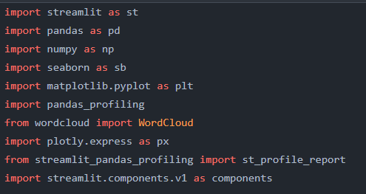
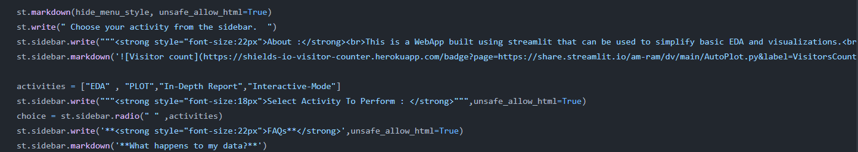
Importing Libraries

Slide 13
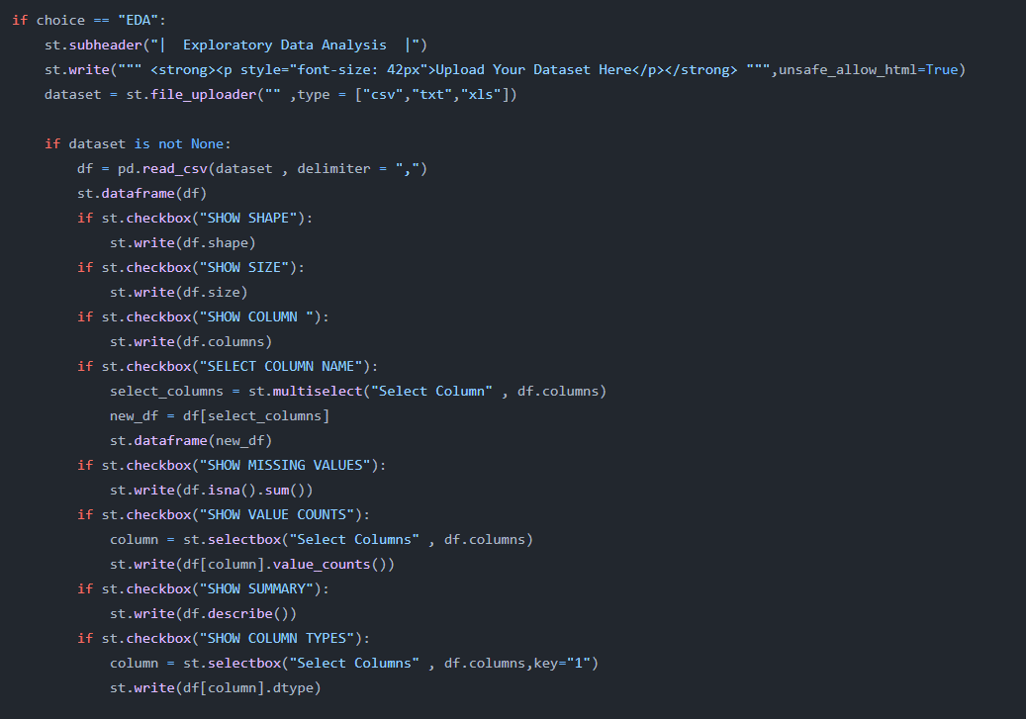
Exploratory Data Analysis

Slide 14
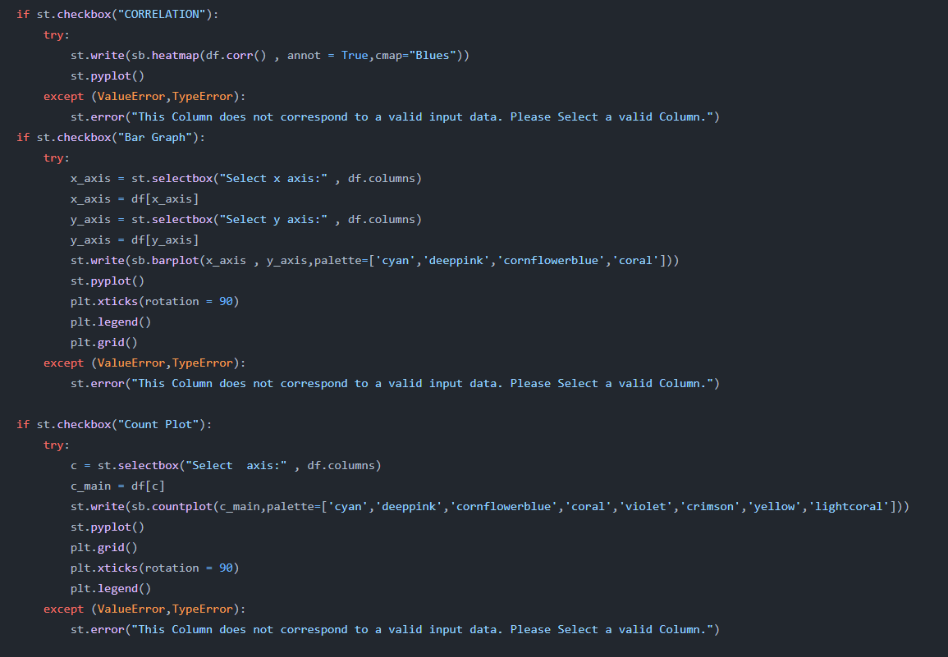
Plots

Slide 15
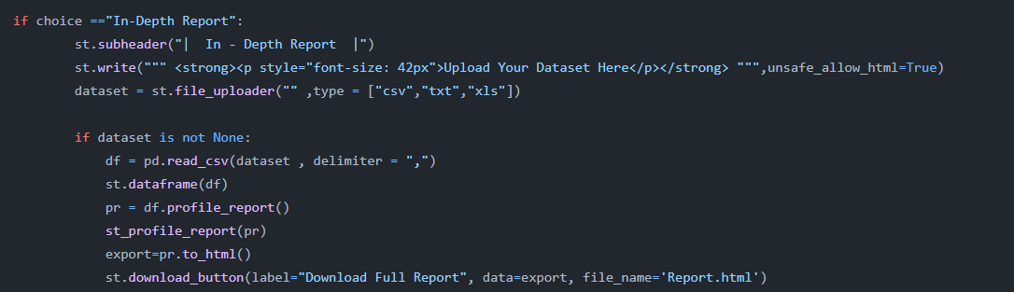
In-Depth Report

Slide 16
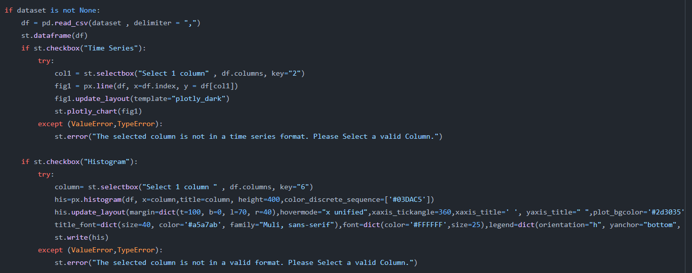
Interactive Mode

Slide 17
Thank You.
Link to the Web-App: - share.streamlit.AutoPlot.py
A project by
Sai Ram. K
20181CSE0621
7 – CSE - 10

